Slide 1

High cloud Airlines

Slide 2

High cloud Airlines
Project name
Mentor
Rajashekar Middishetti
Project members
Anant Raj
Prachi Raj
Poojitha P
Vijay More
Sravanthi. C
Rajaram Setty C V
Shruti Deshpande

Slide 3
Objectives
Improve on-time flight performance
Increase customer satisfaction through service optimization
Identify operational cost-saving opportunities
Use data to enhance decision-making across departments

Slide 4
Overview
provide insights into High Cloud Airlines' operations using data analysis
sets the stage by briefly introducing the airline and highlighting its scale, scope, and market
helps the audience understand the context in which the data analysis is being applied.
data-driven methods to improve customer satisfaction, optimize flight routes, and increase operational efficiency.

Slide 5
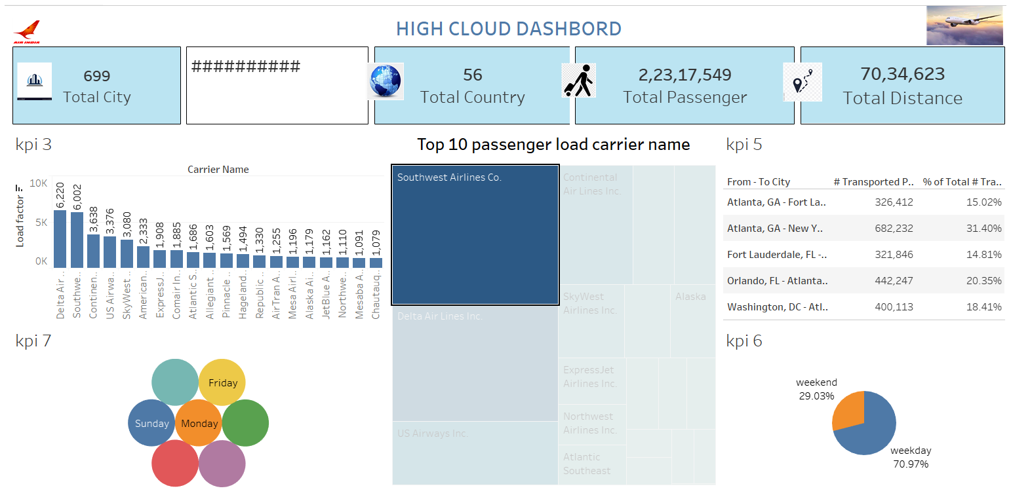
TABLEAU DASHBOARD

Slide 6
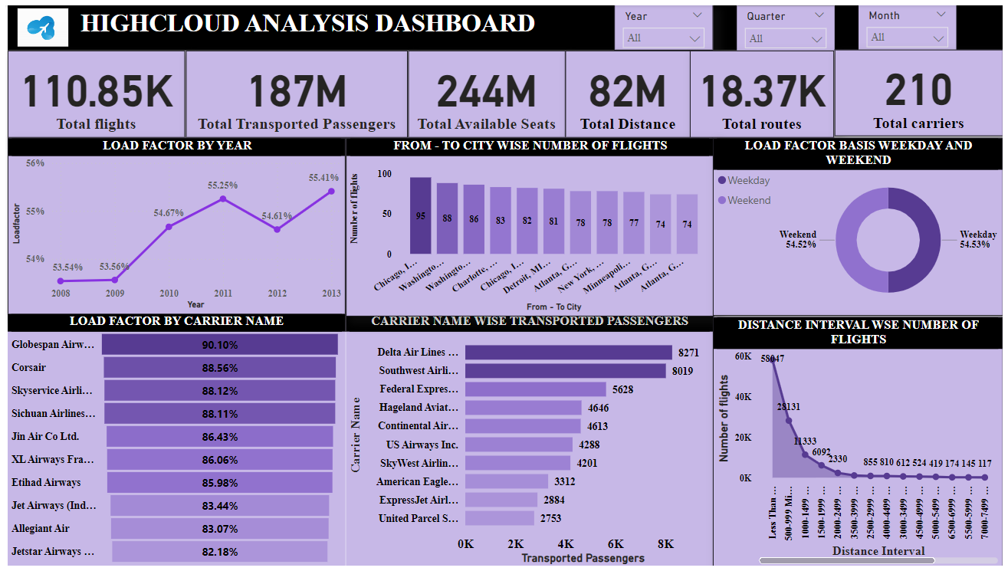
POWER BI DASHBOARD

Slide 7
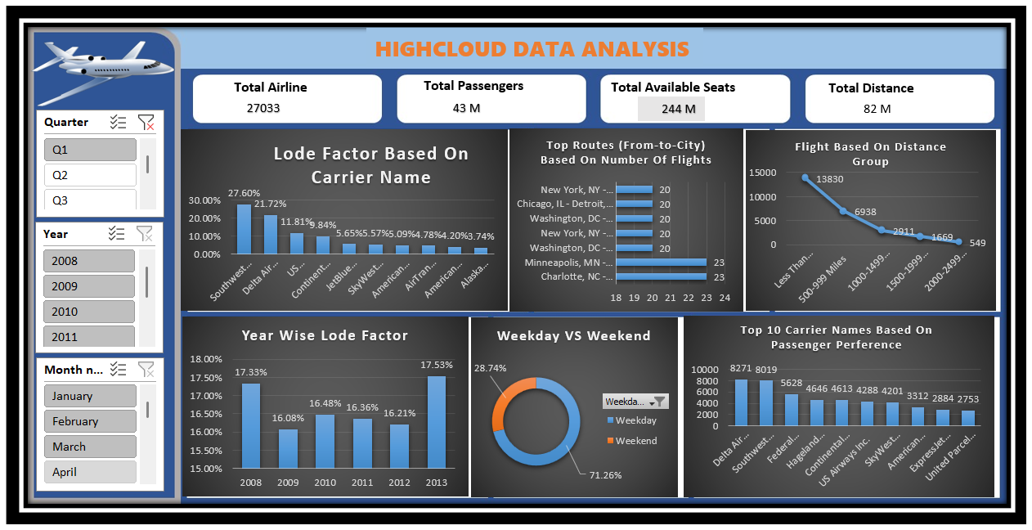
EXCEL DASHBOARD

Slide 8
Data Sources
Internal data: flight schedules, customer feedback, operational logs.
External data: weather data, market trends, competitive benchmarks.
Real-time data: live flight tracking, crew schedules.

Slide 9
Key Metrics and KPIs
Customer satisfaction score
On-time performance (% of flights on time).
Average delay time (minutes).
Revenue per available seat mile (RASM).
Load factor (seat utilization).

Slide 10
Data Analysis Techniques
Descriptive statistics (mean, median, mode).
Regression analysis to predict delays.
Clustering techniques for customer segmentation.
Time-series analysis for flight schedule optimization.

Slide 11
Insights – Customer Satisfaction
Key drivers of satisfaction (e.g., flight punctuality, in-flight services).
Correlation between flight delays and negative customer feedback.
Recommendations for improving customer service.

Slide 12
Insights – Flight Delays
Patterns and causes of delays (e.g., weather, technical issues).
Routes with the highest delay times.
Time-of-day or seasonal patterns affecting delays.

Slide 13
Insights – Revenue and Costs
Most and least profitable routes.
Revenue per seat vs. cost per flight.
Areas of potential cost savings (e.g., fuel optimization, staffing).

Slide 14
Recommendations Customer Experience
Provide real-time flight updates through mobile apps.
Improve in-flight services (e.g., entertainment, meals).
Introduce a loyalty program for frequent flyers.

Slide 15
Recommendations Operational Improvements
Optimize flight schedules to avoid peak delays.
Improve crew scheduling efficiency.
Streamline aircraft turnaround time to reduce delays.

Slide 16
Implementation Strategy
Short-term (1-3 months): Real-time updates, in-flight service improvements.
Medium-term (3-6 months): Flight schedule optimization, route analysis.
Long-term (6-12 months): Cost-saving initiatives, customer retention strategies.

Slide 17
hallenges and Limitations
Data inconsistencies or gaps.
External factors (e.g., weather, fuel prices) impacting predictability.
Limitations in available technology or staff resources.

Slide 18
Conclusion
Summarize key findings and recommendations.
Expected impact on customer satisfaction and operational efficiency.
Future opportunities for further analysis (e.g. expand into predictive analytics).

Slide 19

THANKYOU ! 🙏🏻

